Slide 1
Introduction
Data visualization is a way of representing data in a form of graphical representation to help the viewer to understand the data that is being visualized. Other countries such as United States of America, United Kingdom, Australia and India have visualization their election result data using map visualization. However, most of election data in Malaysia are represented in tabular format and non-interactive graphs. This creates a problem for certain viewers because they could not understand the context of the data. The aim of this project is to represent the election result data in a simplified approach using hexagon tile grid map data visualization. This project utilizes HTML, CSS, Javascript and D3.js library to create hexagon tile grid map data visualization that visualizing the election data in Malaysia map. The system consists of three level of information. The first level shows the hexagon tile grid map of Malaysia. The second level contains the gender distribution of the state. The third level shows the election result with winning party and candidate, besides of ethnic distribution of the selected parliament. This project is validated by comparing the output with the given input data. This project has successfully visualized the election result accurately. This visualization helps to simplify the representation of the election data and the viewer can understand the data easier.

Slide 2
Problem Statement
Tabular format
Hard to understand
Time consuming
Simple graph
Does not convey multiple types of data
Static images
Not interactive
Not dynamic`

Slide 3
Objective
To identify the suitable data visualization technique for Malaysia Election Data.
To develop a system based on the chosen technique for Malaysian Election Data.
To validate the accuracy of visual with the actual election data.

Slide 5
Scope
Malaysia Election Data
Focuses on Parliament (222 seats).
Does not focus on Dewan Undangan Negeri (DUN).
Data Visualization
Use Map Data Visualization, which is more interactive and dynamic.
Apply some data visualization approaches by other similar systems
US, UK, Australia & India.

Slide 6
Significance
Politician
Understand their parliament demography & the comparisons of the votes.
Example: determine which party has won by demographic information.
Public Audience
Understand political condition of the country easier & faster.
Tabular format are overwhelming.
Data Scientist
Learn relationship between the data faster.
Example: relationship between vote counts & demographical information.

Slide 7
Methodology

Slide 8
Sample Interface

Slide 9
Conclusion

Slide 10
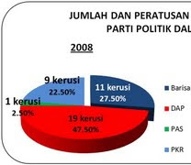
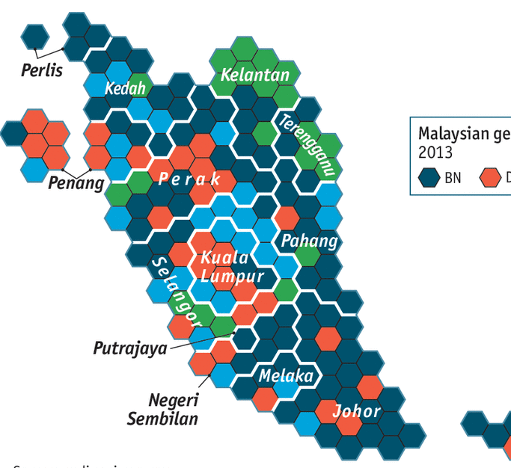
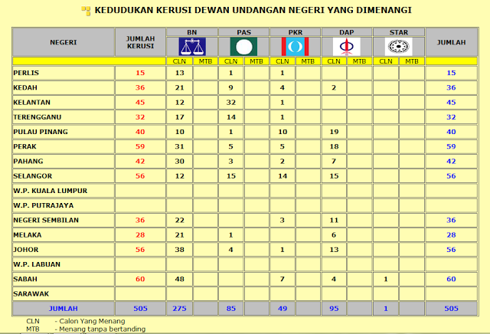
TABULAR
SIMPLE CHART
STATIC IMAGE

Slide 11
